Slide 1
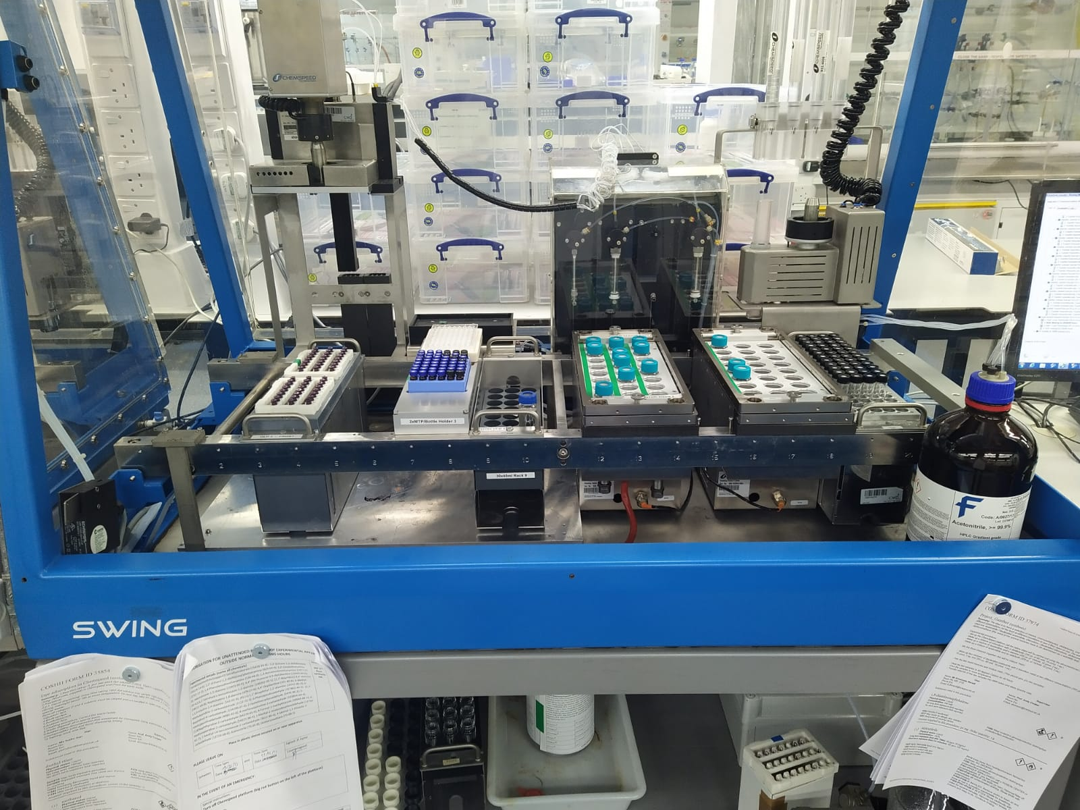
Chemspeed NMR Rack
(holds two housemade NMR racks).
1
8
Chemspeed MTP holder (it’s a rack that
Holds MTP style plates).
2
3
Waters plate (holds 48 LCMS vials).
9
Mosquito plate (holds 96 different 3 microlitre wells).
10
4
5
Vial rack (holds a 60mL vial filled with CH₂Cl₂).
4
12
Shaker rack (holds 32 (20mL) stock solution
vials, has the option to hold 48 vials).
3
6
7
Heater rack (holds 48 (8mL) reaction vials,
has the option to hold 80 vials).
1
2
5
6
6
7
11
8
Needle head.
One 1mL, two 20mL syringes and their
actuators. This is the liquid backbone.
9
10
Crimper head (not used
in project).
11
CH₃CN solvent bottle.
12
Computer responsible for writing and running Chemspeed scripts.
13
13
Waste.

